Slide 1

In the Written Word
Michael Christie

Slide 2

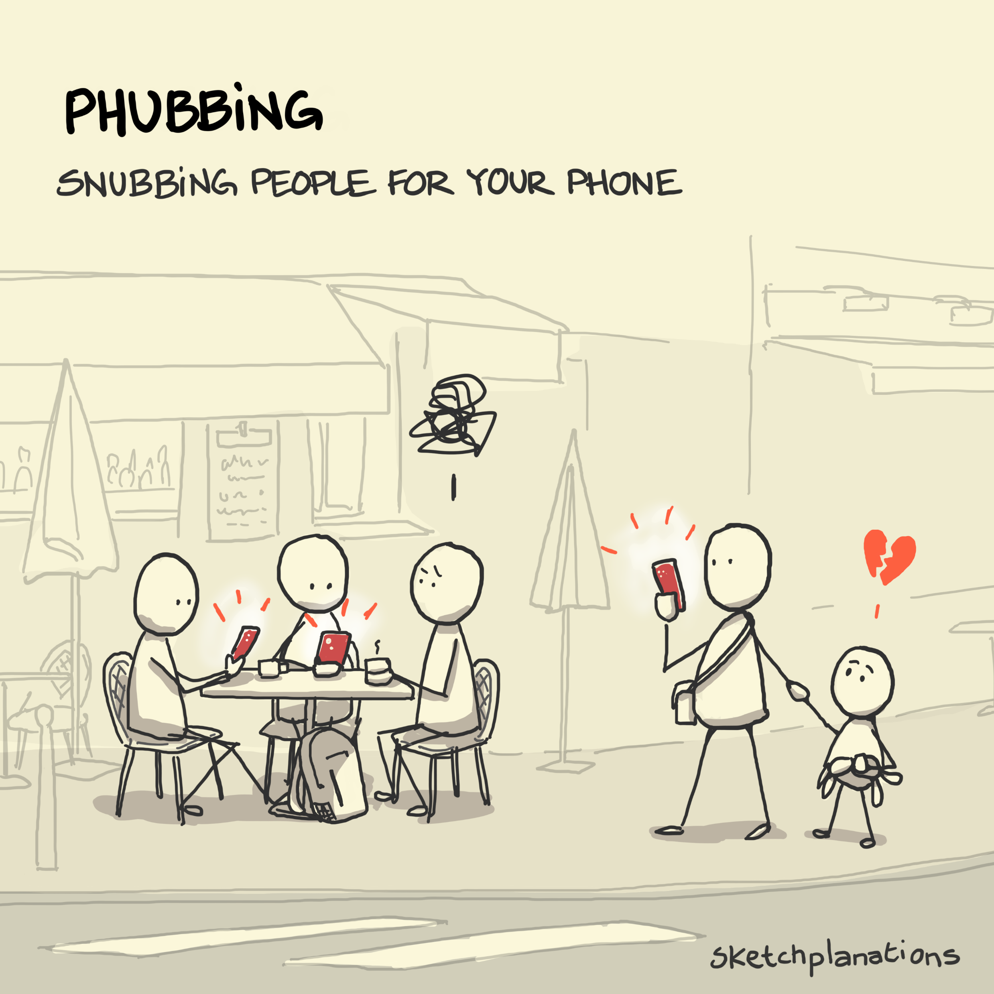
https://sketchplanations.com/phubbing

Slide 3
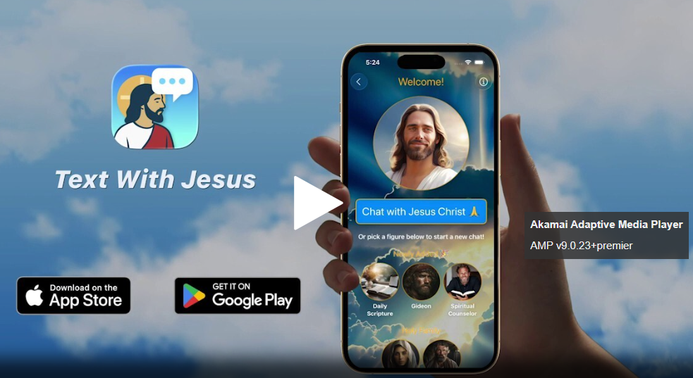

Slide 4
‘Man shall not live on bread alone, but on every word that comes from the mouth of God.’
- MATTHEW 4:4

Slide 5
As disciples of Jesus Christ, I believe we cannot abandon faith in our ability to hear from God. To abandon this is to abandon the reality of a personal relationship with God, and that we must not do. Our hearts and minds, as well as the realities of the Christian tradition, stand against it.
- DALLAS WILLARD

Slide 6
2 TIMOTHY 3:10-17
¹⁰ You, however, know all about my teaching, my way of life, my purpose, faith, patience, love, endurance, ¹¹
persecutions, sufferings—what kinds of things happened to me in Antioch, Iconium and Lystra, the persecutions I endured. Yet the Lord rescued me from all of them.

Slide 7
¹² In fact, everyone who wants to live a godly life in Christ Jesus will be persecuted, ¹³ while evildoers and impostors will go from bad to worse, deceiving and being deceived.
¹⁴ But as for you, continue in what you have learned and have become convinced of, because you know those from whom you learned it,

Slide 8
¹⁵ and how from infancy you have known the Holy Scriptures, which are able to make you wise for salvation through faith in Christ Jesus.
¹⁶ All Scripture is God-breathed and is useful for teaching, rebuking, correcting and training in righteousness, ¹⁷ so that the servant of God may be thoroughly equipped for every good work.

Slide 9


Slide 10
When we open the Bible, we enter the totally unfamiliar world of God, a world of creation and salvation stretching endlessly above and beyond us. Life in the warehouse never prepared us for anything like this.
- KARL BARTH

Slide 11
His Person
But as for you, continue in what you have learned and have become convinced of, because you know those from whom you learned it, and how from infancy you have known the Holy Scriptures... All Scripture is God-breathed…
- 2 TIMOTHY 3:14-16a

Slide 12


Slide 13
The Bible—banned, burned, beloved. More widely read, more frequently attacked than any other book in history.
- CHARLES COLSON

Slide 14
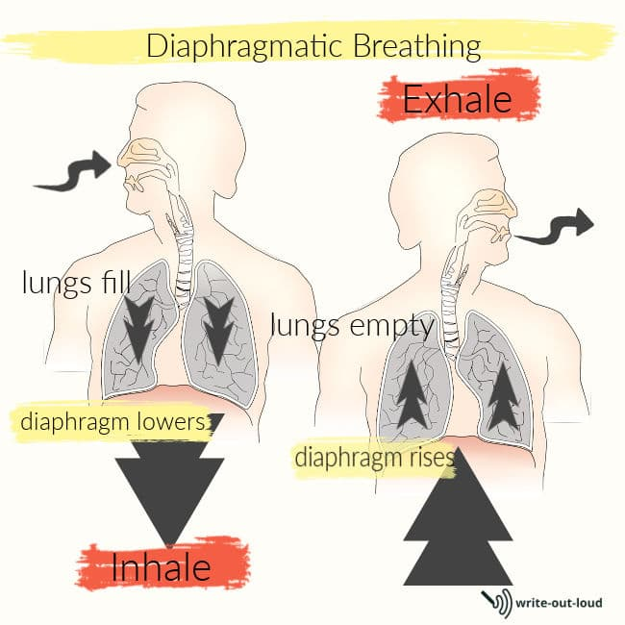

Slide 15
By the word of the Lord the heavens were made, their starry host by the breath of his mouth.
PSALM 33:6
The LORD God formed a man from the dust of the ground and breathed into his nostrils the breath of life, and the man became a living being.
- GENESIS 2:7

Slide 16
For the word of God is alive and active. Sharper than any double-edged sword, it penetrates even to dividing soul and spirit...
- HEBREWS 4:12

Slide 17
I trust the Bible because I trust in Jesus. I love him, and I’ve decided to follow him, so if he talks and acts as if the Bible is trustworthy, authoritative, good, helpful and powerful, I will too… Even if some of my questions remain unanswered, or my answers remain unpopular.
ANDREW WILSON
Unbreakable: What the Son of God said about the Word of God

Slide 18
His Process
[The Holy Scriptures] are able to make you wise for salvation through faith in Christ Jesus. All Scripture is God-breathed and is useful for teaching, rebuking, correcting and training in righteousness…
- 2 TIMOTHY 3:15-16

Slide 19


Slide 20
The Bible is not an end in itself, but a means to bring men to an intimate and satisfying knowledge of God, that they may enter into Him, that they may delight in His Presence, may taste and know the inner sweetness of the very God Himself in the core and centre of their hearts.
AW TOZER
The Pursuit of God

Slide 21


Slide 22
His Purpose
All Scripture is God-breathed and is useful … so that the servant of God may be thoroughly equipped for every good work.
(ESV. that the man of God may be complete, equipped for every good work.)
- 2 TIMOTHY 3:17

Slide 23
Bible Reading Suggestion - BREAD
Be Still
Read the Bible (or listen)
Encounter
Apply
Devote

Slide 24
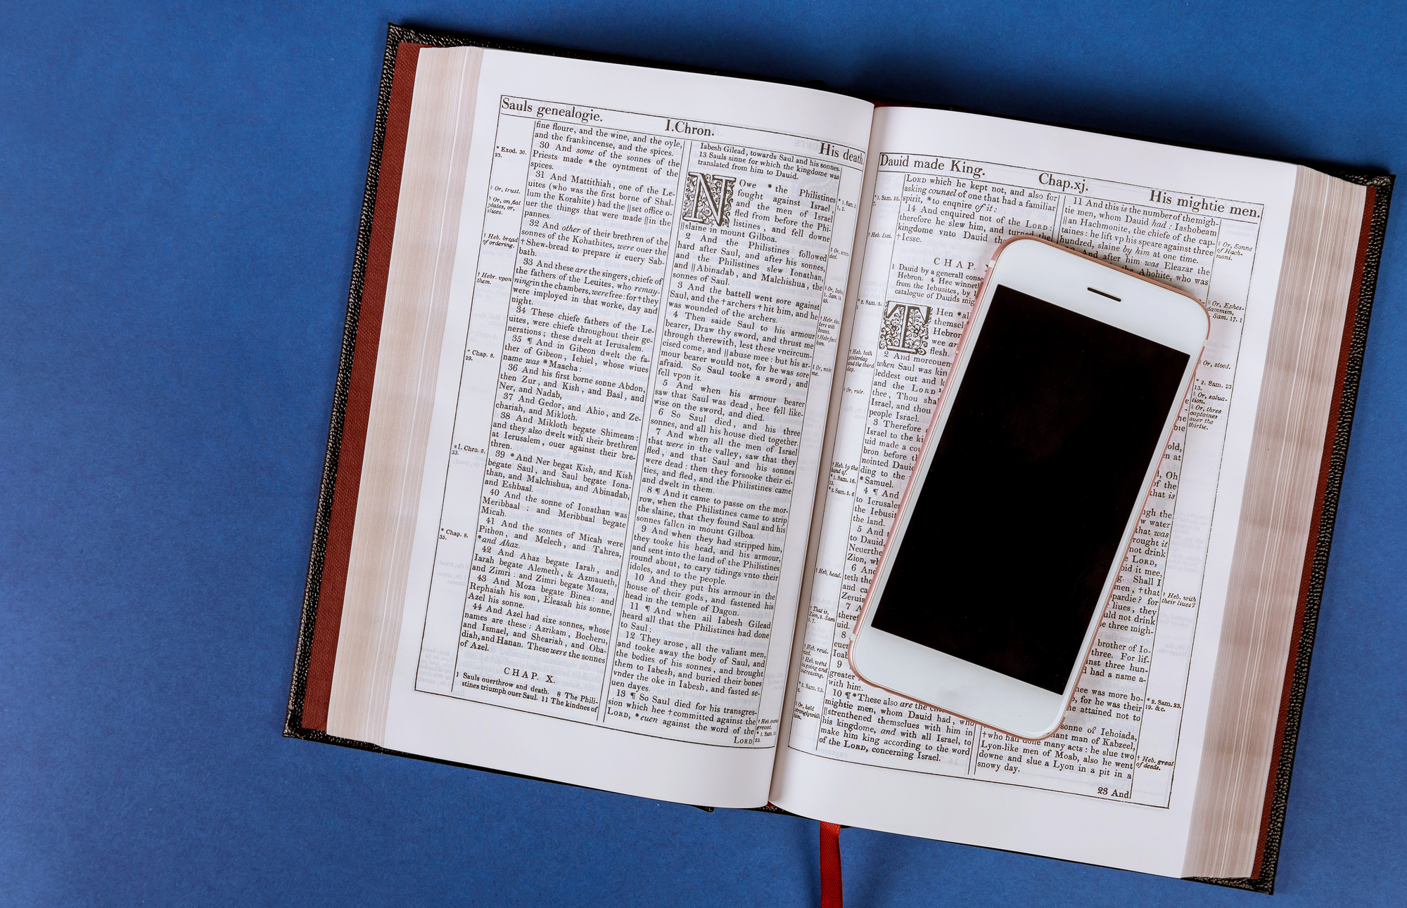

Slide 25
The teachings of the Bible, no matter how thoroughly studied and firmly believed, can never by themselves constitute our personal walk with God. They have to be applied to us as individuals and to our individualised circumstances or they remain no part of our lives.
- DALLAS WILLARD

Slide 26
