Slide 1

Where does my Help Come From
Robyn Christie

Slide 2



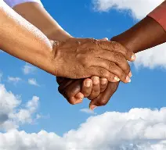

HELP!!!!!!

Slide 3
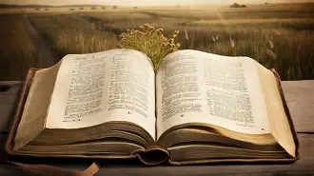

Slide 4
Jeremiah 31:33-34
“This is the covenant I will make with the people of Israel after that time,” declares the Lord.
“I will put my law in their minds and write it on their hearts. I will be their God, and they will be my people.

Slide 5
No longer will they teach their neighbour, or say to one another, ‘Know the Lord,’
because they will all know me, from the least of them to the greatest,”
declares the Lord.
“For I will forgive their wickedness and will remember their sins no more.

Slide 6
Daniel 10:4 -21
4 On the twenty-fourth day of the first month, as I was standing on the bank of the great river, the Tigris, 5 I looked up and there before me was a man dressed in linen, with a belt of fine gold from Uphaz around his waist.
6 His body was like topaz, his face like lightning, his eyes like flaming torches,

Slide 7
his arms and legs like the gleam of burnished bronze, and his voice like the sound of a multitude.
7 I, Daniel, was the only one who saw the vision; those who were with me did not see it, but such terror overwhelmed them that they fled and hid themselves. 8 So I was left alone, gazing at this great vision; I had no strength left, my face

Slide 8
turned deathly pale and I was helpless.
9Then I heard him speaking, and as I listened to him, I fell into a deep sleep, my face to the ground.
10 A hand touched me and set me trembling on my hands and knees. 11 He said, “Daniel, you who are highly esteemed, consider carefully the words I am about to

Slide 9
speak to you, and stand up, for I have now been sent to you.” And when he said this to me, I stood up trembling.
12 Then he continued, “Do not be afraid, Daniel. Since the first day that you set your mind to gain understanding and to humble yourself before your God, your words were heard, and I have come in response to them.

Slide 10
13 But the prince of the Persian kingdom resisted me twenty-one days. Then Michael, one of the chief princes, came to help me, because I was detained there with the king of Persia. 14 Now I have come to explain to you what will happen to your people in the future, for the vision concerns a time yet to come.”

Slide 11
15 While he was saying this to me, I bowed with my face toward the ground and was speechless. 16 Then one who looked like a man touched my lips, and I opened my mouth and began to speak. I said to the one standing before me, “I am overcome with anguish because of the vision, my lord, and I feel very weak.

Slide 12
17 How can I, your servant, talk with you, my lord? My strength is gone and I can hardly breathe.”
18 Again the one who looked like a man touched me and gave me strength.
19 “Do not be afraid, you who are highly esteemed,” he said. “Peace! Be strong now; be strong.”

Slide 13
When he spoke to me, I was strengthened and said, “Speak, my lord, since you have given me strength.”

Slide 14
Daniel matters to God.
11b A hand touched me and set me trembling on my hands and knees. 11 He said, “Daniel, you who are highly esteemed, consider carefully the words I am about to speak to you, and stand up, for I have now been sent to you.”

Slide 15
Daniel’s prayer matters.
12 Then he said to me, “Fear not, Daniel, for from the first day that you set your heart to understand and humbled yourself before your God, your words have been heard, and I have come because of your words.

Slide 16
Colossians 1:9
For this reason, since the day we heard about you, we have not stopped praying for you. We continually ask God to fill you with the knowledge of his will through all the wisdom and understanding that the Spirit gives,

Slide 17
Colossians 2:2
My goal is that they may be encouraged in heart and united in love, so that they may have the full riches of complete understanding, in order that they may know the mystery of God, namely, Christ,

Slide 18
your words were heard, and I have come in response to them. 13 But the prince of the Persian kingdom resisted me twenty-one days. Then Michael, one of the chief princes, came to help me, because I was detained there with the king of Persia. 14 Now I have come to explain to you what will happen to your people in the future, for the vision concerns a time yet to come.”
Daniel v12b-14

Slide 19
Ephesians 6:10 -12
10 Finally, be strong in the Lord and in his mighty power. 11 Put on the full armor of God, so that you can take your stand against the devil’s schemes. 12 For our struggle is not against flesh and blood, but against the rulers, against the authorities, against the powers of this dark world and against the spiritual forces of evil in the heavenly realms.

Slide 20
Ephesians 6:18
18 Pray in the Spirit at all times in every prayer and supplication. To that end, keep alert and always persevere in supplication for all the saints.

Slide 21
Daniel’s participation matters
18 Again the one who looked like a man touched me and gave me strength. 19 “Do not be afraid, you who are highly esteemed,” he said. “Peace! Be strong now; be strong.”
When he spoke to me, I was strengthened and said, “Speak, my lord, since you have given me strength.”

Slide 22
Isaiah 60:1-4a
“Arise, shine, for your light has come,
and the glory of the Lord rises upon you.
2 See, darkness covers the earth
and thick darkness is over the peoples,
but the Lord rises upon you
and his glory appears over you.
3 Nations will come to your light,
and kings to the brightness of your dawn.
4 “Lift up your eyes and look about you:

Slide 23
“Victory begins with the name of Jesus on our lips. It is consummated with the nature of Jesus in our hearts. “
Francis Frangipane

Slide 24
“The assumption of spirituality is that always God is doing something before I know it.
So the task is not to get God to do something I think needs to be done but to become aware of what God is doing so that I can respond and participate and take delight in it.”
Eugene Peterson
The Contemplative Pastor

Slide 25
2 Peter 1:3 – 4
His divine power has given us everything we need for a godly life through our knowledge of him who called us by his own glory and goodness. 4 Through these he has given us his very great and precious promises, so that through them you may participate in the divine nature, having escaped the corruption in the world caused by evil desires.

Slide 26
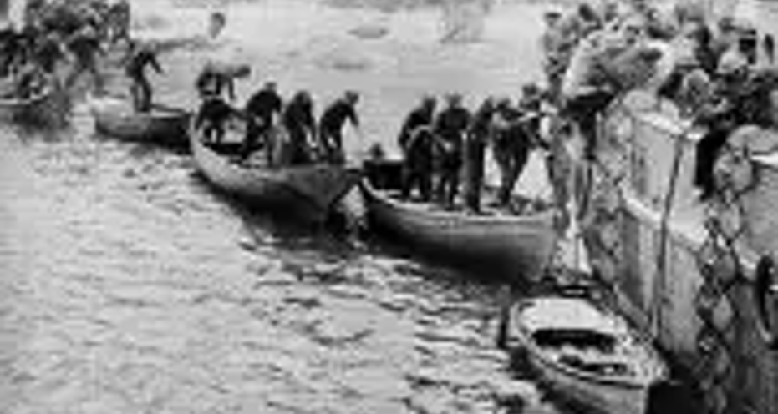
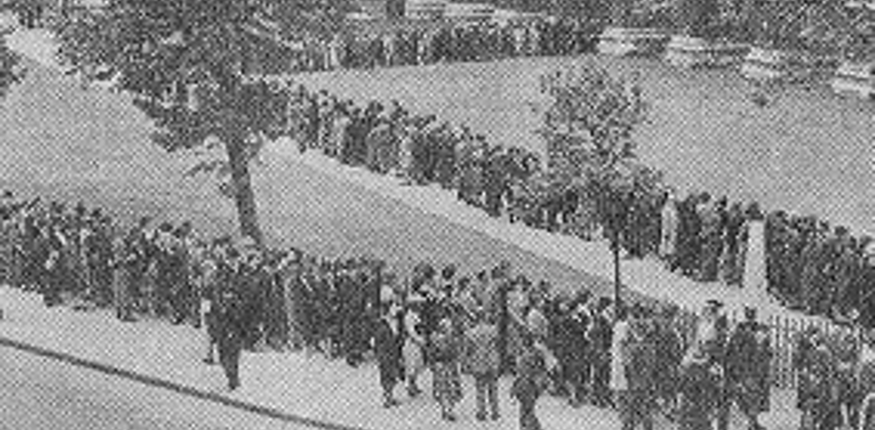
Dunkirk 1940

