Slide 1

Dangerous Devotion
Michael Christie

Slide 2



Slide 3
ACTS 2:40-47
⁴⁰ With many other words he warned them; and he pleaded with them, “Save yourselves from this corrupt generation.” ⁴¹ Those who accepted his message were baptized, and about three thousand were added to their number that day.

Slide 4
⁴² They devoted themselves to the apostles’ teaching and to fellowship, to the breaking of bread and to prayer.
⁴³ Everyone was filled with awe at the many wonders and signs performed by the apostles.
⁴⁴ All the believers were together and had everything in common. ⁴⁵ They sold property and possessions to give to anyone who had need.

Slide 5
⁴⁶ Every day they continued to meet together in the temple courts.
They broke bread in their homes and ate together with glad and sincere hearts, ⁴⁷ praising God and enjoying the favour of all the people.
And the Lord added to their number daily those who were being saved.

Slide 6
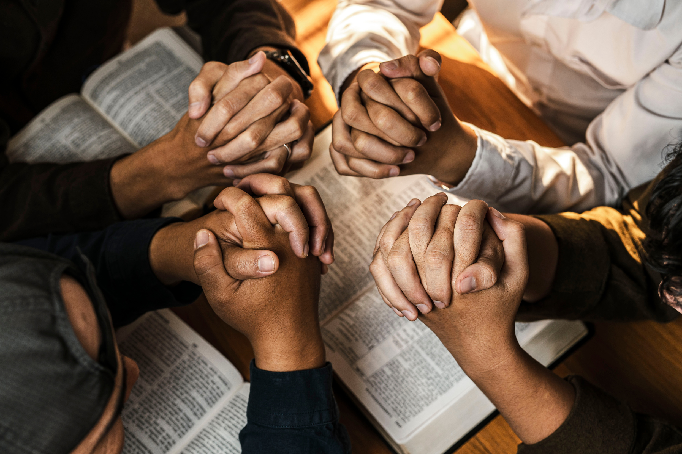

Slide 7
Devoted to the Lord
They devoted themselves to the apostles’ teaching… and to prayer… Every day they continued to meet together in the temple courts. They broke bread in their homes and ate together with glad and sincere hearts, praising God…
- ACTS 2:42-47

Slide 8
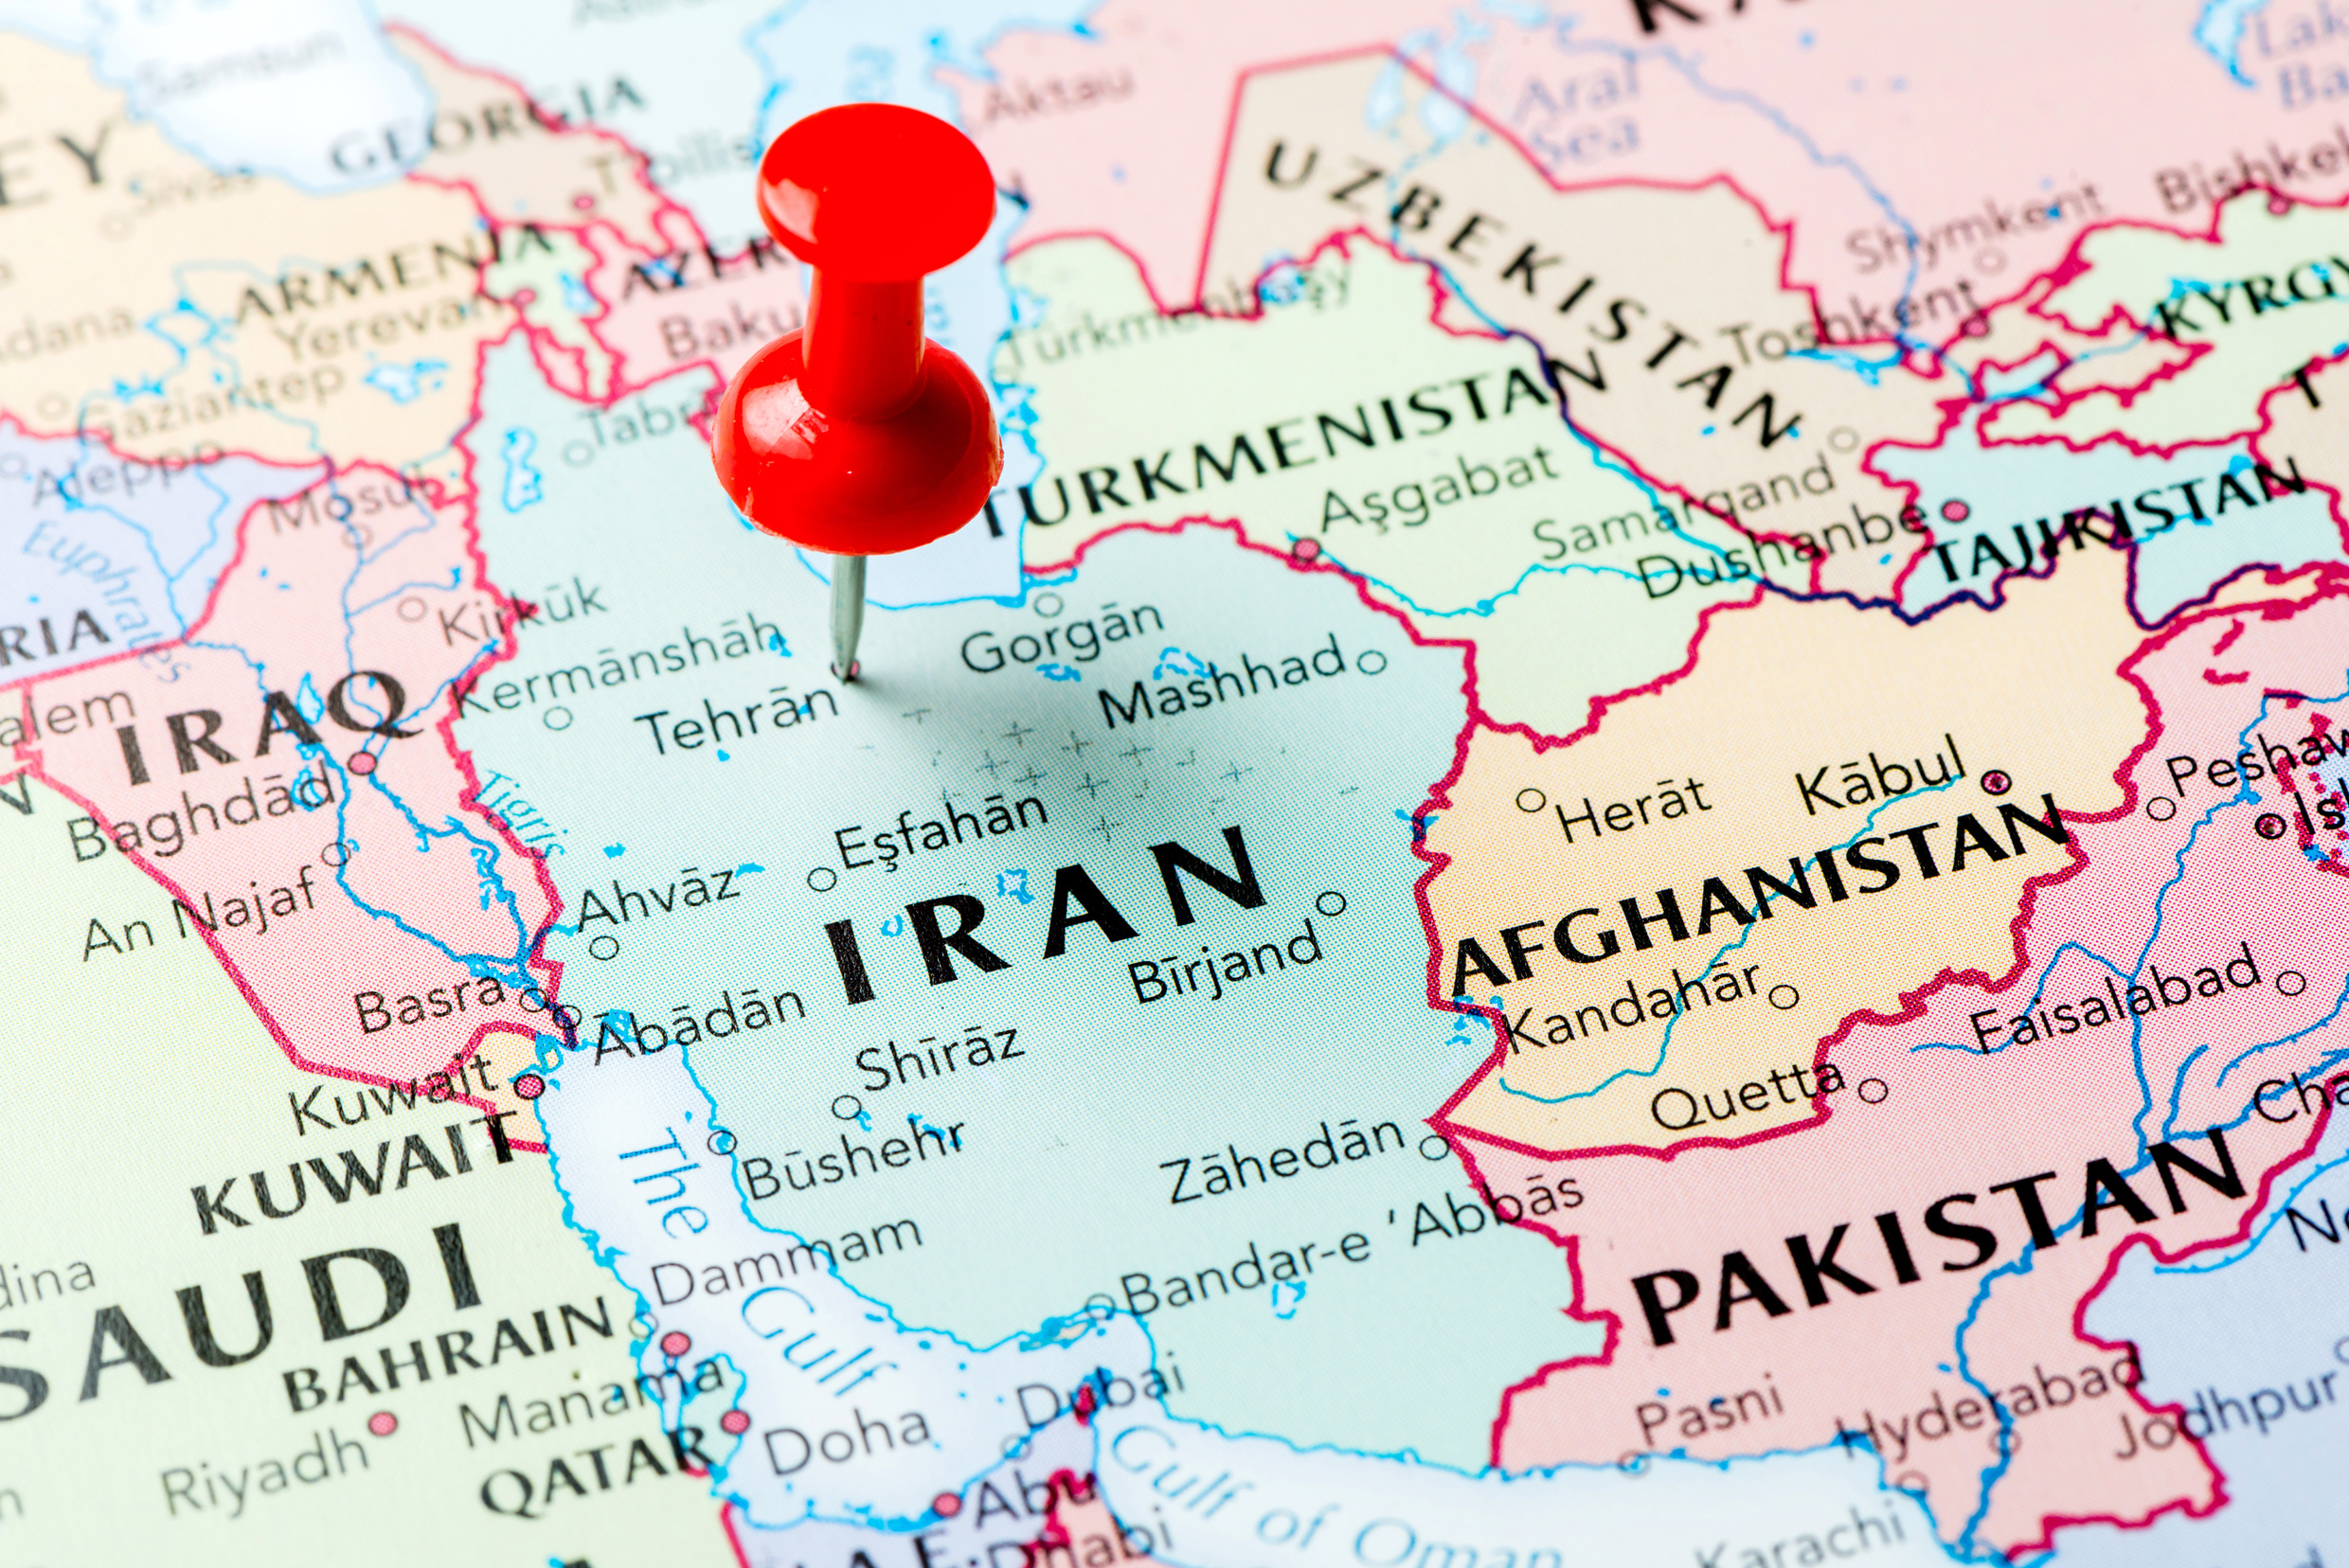

Slide 9
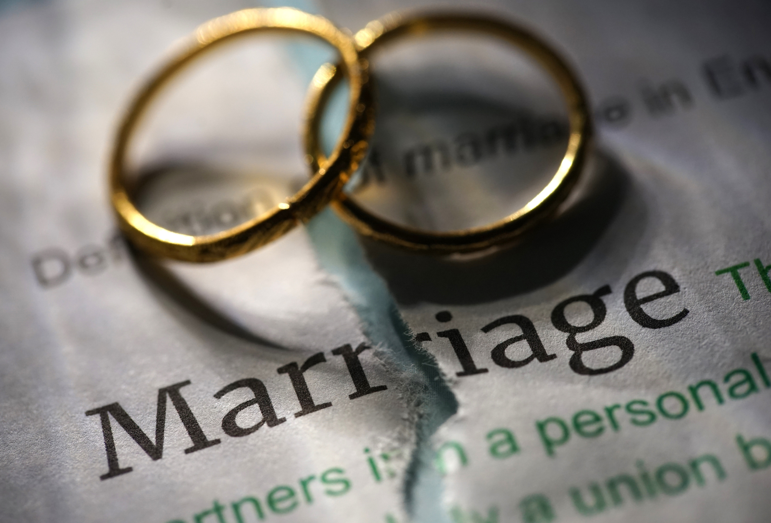

Slide 10
For them I sanctify myself, that they too may be truly sanctified… in order that the love you have for me may be in them and that I myself may be in them.
- JOHN 17:19, 26

Slide 11
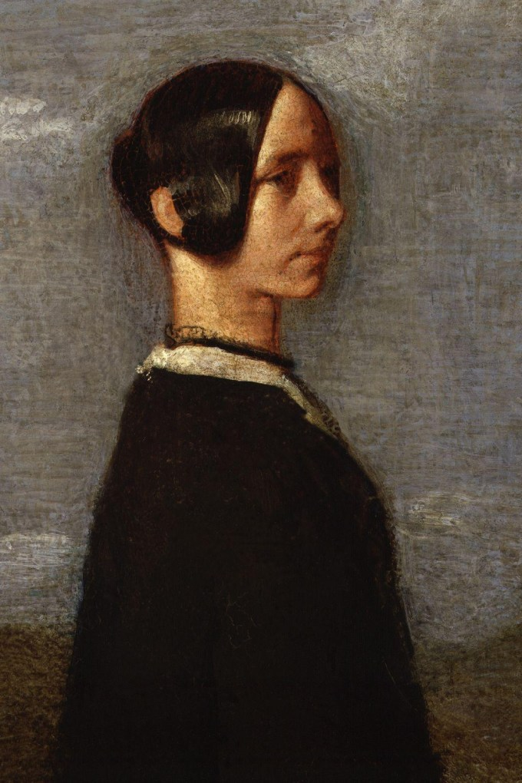
Jane Welsh Carlyle
By Samuel Laurence
1952

Slide 12
Devoted to One Another
They devoted themselves to the apostles’ teaching AND to fellowship… all the believers were together and had everything in common. They sold property and possessions to give to anyone who had need. Every day they continued to meet together in the temple courts. They broke bread in their homes and ate together.
- ACTS 2:42-46

Slide 13
1 JOHN 1:4:
We proclaim to you what we have seen and heard, so that you also may have fellowship with us. And our fellowship is with the Father and with his Son, Jesus Christ.
2 CORINTHIANS 13:14:
May the grace of the Lord Jesus Christ, and the love of God, and the fellowship of the Holy Spirit be with you all.

Slide 14
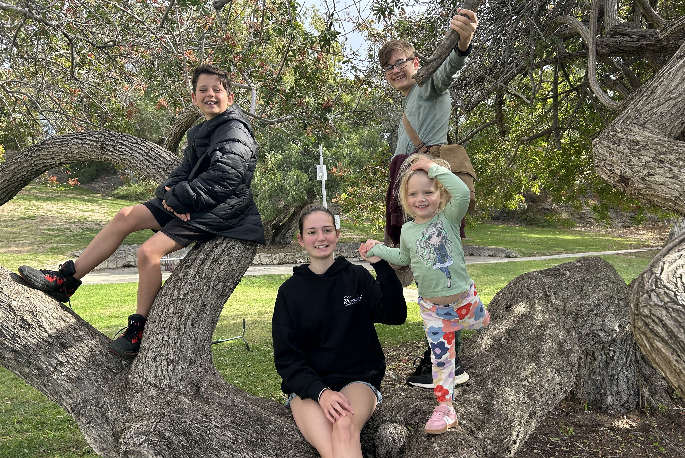

Slide 15
By this everyone will know that you are my disciples, if you love one another.
- JOHN 13:35

Slide 16
Their founder [Jesus] taught them that they should be like brothers to one another and therefore they despise their own privacy and view their possessions as common property.
- LUCIAN

Slide 17
Devoted to the World
They… [were] praising God and enjoying the favour of all the people. And the Lord added to their number daily those who were being saved.
- ACTS 2:46-47

Slide 18
[Acts] is governed by one dominant, overriding and all-controlling motif. This motif is the expansion of the faith through missionary witness in the power of the Spirit… Restlessly the Spirit drives the church to witness, and continually churches rise out of the witness.
- HARRY BOER
Pentecost and Missions

Slide 19
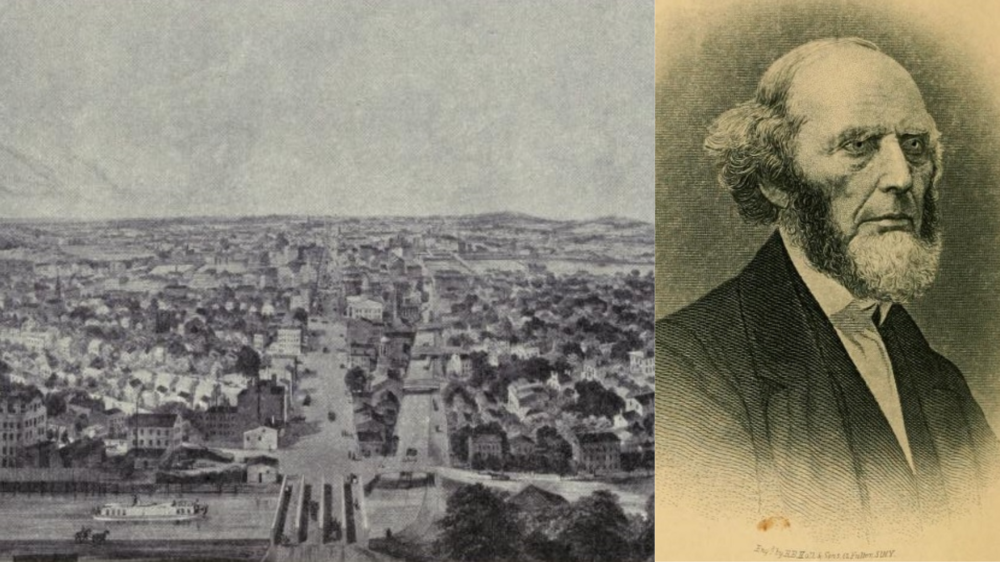

Slide 20
There is no need for us to wait for the Spirit to come. For the Holy Spirit did come on the Day of Pentecost, and has never left his church. Our responsibility is to humble ourselves before his sovereign authority, to determine not to quench him, but to allow him his freedom. For then our churches will again manifest those marks of the Spirit’s presence, which many… are specially looking for.
- JOHN STOTT

Slide 21
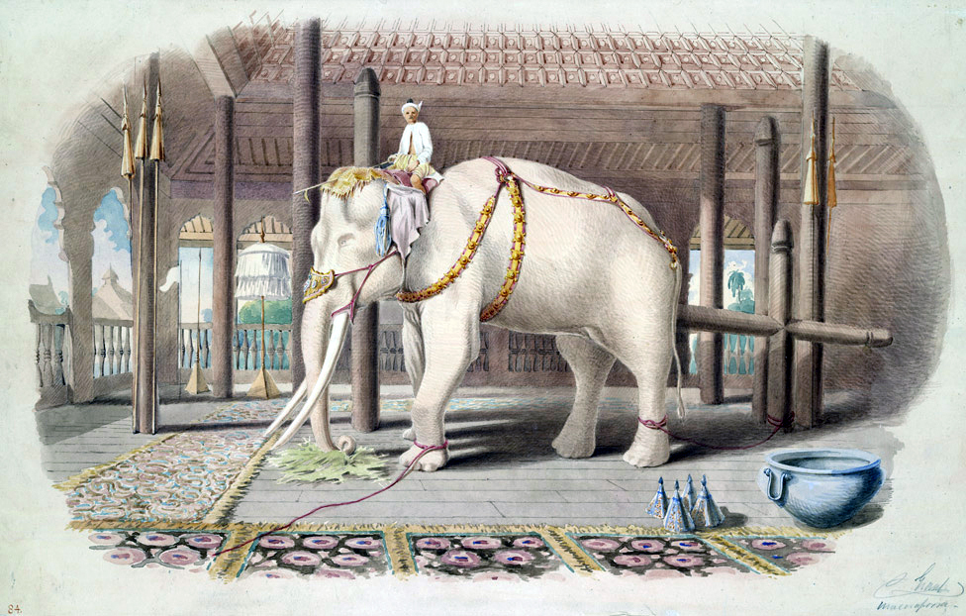
By Colesworthey Grant - Public Domain, https://commons.wikimedia.org/w/index.php?curid=19253012

