Slide 1

What’s In a Name?
Michael Christie

Slide 2

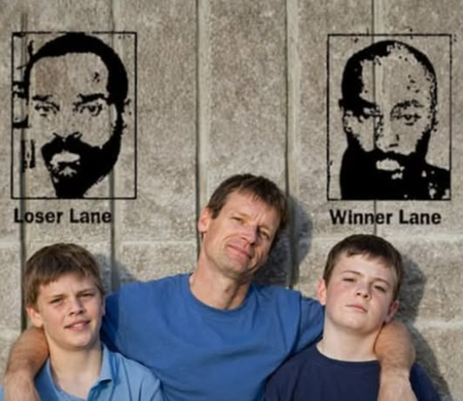

Slide 3

Researchers have shown that our names take root deep within our mental worlds, drawing us magnetically towards the concepts they embody.
- PROFESSOR ADAM ALTER

Slide 4
ACTS 3:2-8; 11-20
² Now a man who was lame from birth was being carried to the temple gate called Beautiful, where he was put every day to beg from those going into the temple courts. ³ When he saw Peter and John about to enter, he asked them for money. ⁴ Peter looked straight at him, as did John. Then Peter said, “Look at us!”

Slide 5
⁵ So the man gave them his attention, expecting to get something from them.
⁶ Then Peter said, “Silver or gold I do not have, but what I do have I give you. In the name of Jesus Christ of Nazareth, walk.”
⁷ Taking him by the right hand, he helped him up, and instantly the man’s feet and ankles became strong. ⁸ He jumped to his feet and began to walk. Then he went with them into the temple courts, walking and jumping, and praising God.

Slide 6
¹¹ While the man held on to Peter and John, all the people were astonished and came running to them in the place called Solomon’s Colonnade.
¹² When Peter saw this, he said to them: “Fellow Israelites, why does this surprise you? Why do you stare at us as if by our own power or godliness we had made this man walk?

Slide 7
¹³ The God of Abraham, Isaac and Jacob, the God of our fathers, has glorified his servant Jesus. You handed him over to be killed, and you disowned him before Pilate, though he had decided to let him go.
¹⁴ You disowned the Holy and Righteous One and asked that a murderer be released to you. ¹⁵ You killed the author of life, but God raised him from the dead. We are witnesses of this.

Slide 8
¹⁶ By faith in the name of Jesus, this man whom you see and know was made strong. It is Jesus’ name and the faith that comes through him that has completely healed him, as you can all see. ¹⁷ “Now, fellow Israelites, I know that you acted in ignorance, as did your leaders. ¹⁸ But this is how God fulfilled what he had foretold through all the prophets, saying that his Messiah would suffer.

Slide 9
¹⁹ Repent, then, and turn to God, so that your sins may be wiped out, that times of refreshing may come from the Lord, ²⁰ and that he may send the Messiah, who has been appointed for you—even Jesus.

Slide 10
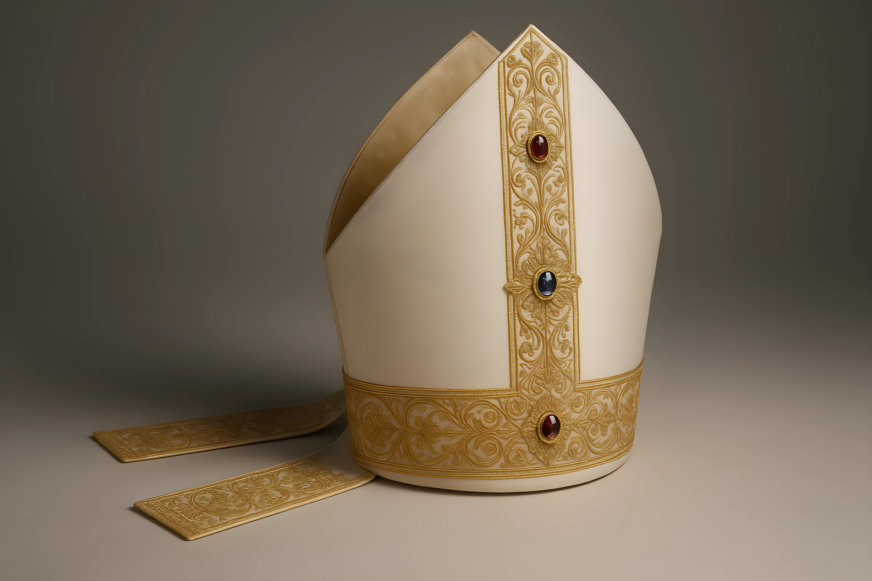

Slide 11
NEED Identified
A man who was lame from birth was being carried to the temple gate called Beautiful, where he was put every day to beg from those going into the temple courts. When he saw Peter and John about to enter, he asked them for money. Peter looked straight at him, as did John. Then Peter said, “Look at us!”
- ACTS 3:2-4

Slide 12
It is not the Church’s business in this world to simply make the present condition more bearable; the task of the Church is to release here on earth the redemptive work of God in Christ.
- WILLIAM LASOR

Slide 13
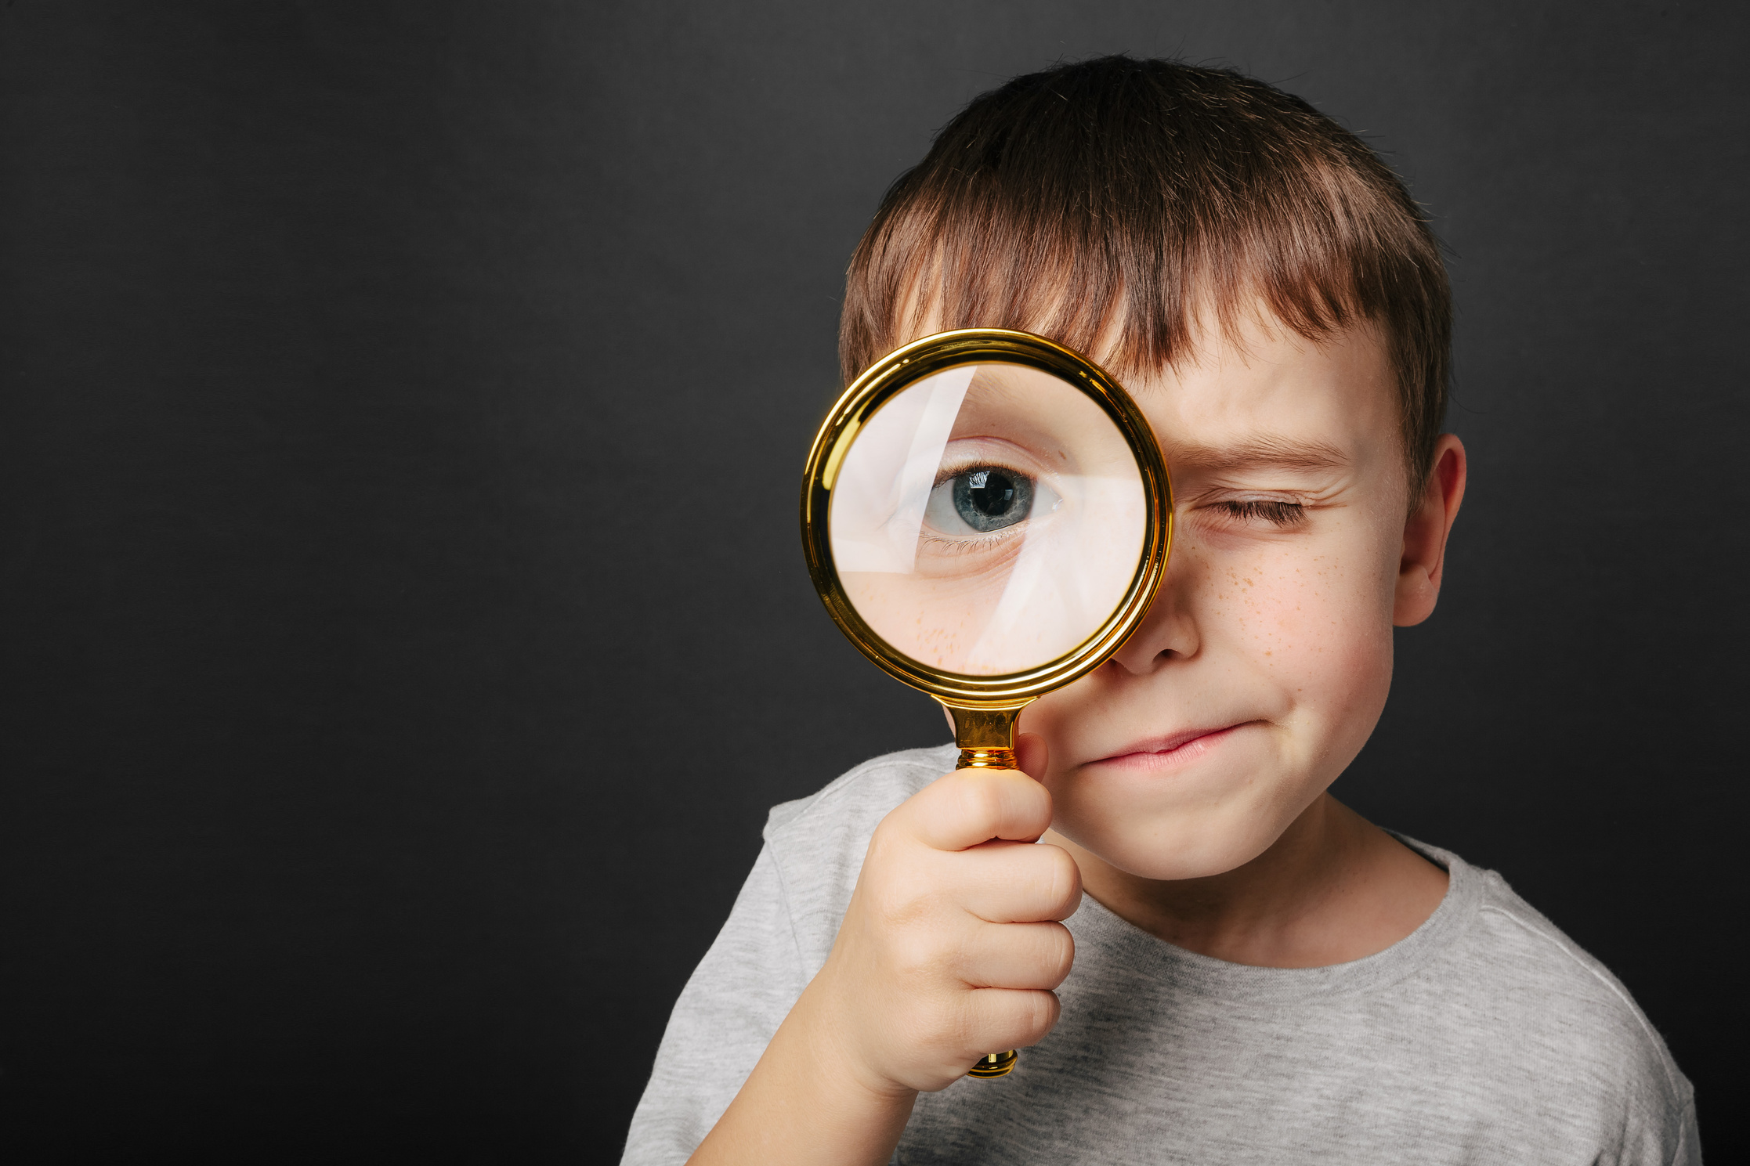

Slide 14
NAME Glorified
Peter said, “Silver or gold I do not have, but what I do have I give you. In the name of Jesus Christ of Nazareth, walk.” Taking him by the right hand, he helped him up, and instantly the man’s feet and ankles became strong. He jumped to his feet and began to walk. Then he went with them into the temple courts, walking and jumping, and praising God.
- ACTS 3:6-8

Slide 15
God exalted him to the highest place and gave him the name that is above every name.
- PHILIPPIANS 2:9

Slide 16
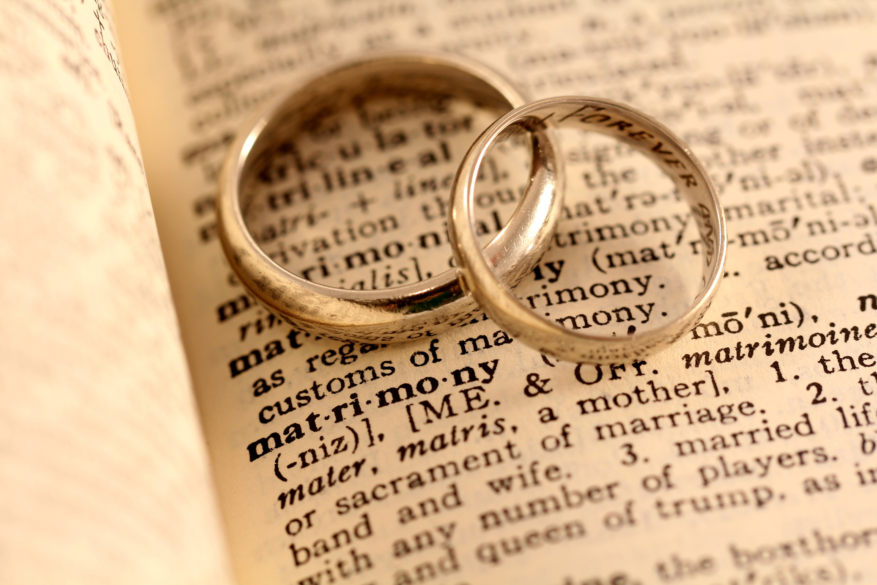

Slide 17
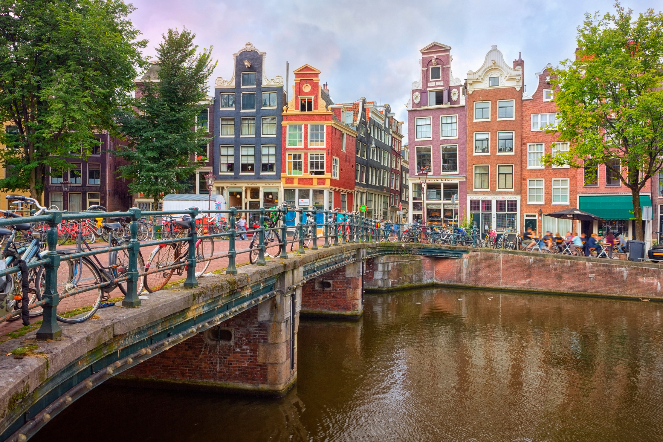

Slide 18
Just as the world is becoming more aware of its need, the church is becoming less assured of its mission. And the major reason for the diminishing Christian mission is the diminishing confidence in the Christian message.
- JOHN STOTT

Slide 19
NOTICE Required
Repent, then, and turn to God, so that your sins may be wiped out, that times of refreshing may come from the Lord, and that he may send the Messiah, who has been appointed for you—even Jesus.
- ACTS 3:19-20

Slide 20
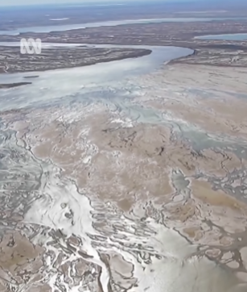
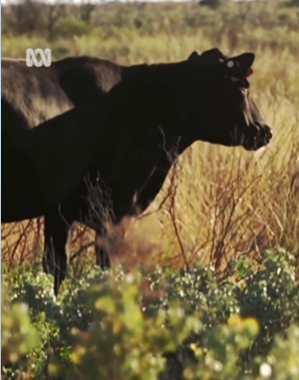

Slide 21
