Slide 1

Boldness during Battle
Michael Christie

Slide 2



Slide 3
It looks more and more likely that our culture, based as it is on self-satisfaction, will at a certain moment collapse and then we as humanity will face a worldwide calamity that will occur without warning. It may yet take a while, but there’s no doubt it will come.
- J.H. BAVINCK
The Riddle of Life

Slide 4
ACTS 4:1-4; 18, 21, 23-31
¹ The priests and the captain of the temple guard and the Sadducees came up to Peter and John while they were speaking to the people. ² They were greatly disturbed because the apostles were teaching the people, proclaiming in Jesus the resurrection of the dead.

Slide 5
³ They seized Peter and John and, because it was evening, they put them in jail until the next day. ⁴ But many who heard the message believed; so the number of men who believed grew to about five thousand…
¹⁸ Then they called them in again and commanded them not to speak or teach at all in the name of Jesus… ²¹ After further threats they let them go.

Slide 6
²³ On their release, Peter and John went back to their own people and reported all that the chief priests and the elders had said to them.
²⁴ When they heard this, they raised their voices together in prayer to God. “Sovereign Lord,” they said, “you made the heavens and the earth and the sea, and everything in them.

Slide 7
²⁵ You spoke by the Holy Spirit through the mouth of your servant, our father David: “‘Why do the nations rage and the peoples plot in vain? ²⁶ The kings of the earth rise up and the rulers band together against the Lord and against his anointed one.’ ²⁷ Indeed Herod and Pontius Pilate met together with the Gentiles and the people of Israel in this city to conspire against your holy servant Jesus, whom you anointed.

Slide 8
²⁸ They did what your power and will had decided beforehand should happen.
²⁹ Now, Lord, consider their threats and enable your servants to speak your word with great boldness.
³⁰ Stretch out your hand to heal and perform signs and wonders through the name of your holy servant Jesus.”

Slide 9
³¹ After they prayed, the place where they were meeting was shaken. And they were all filled with the Holy Spirit and spoke the word of God boldly.

Slide 10
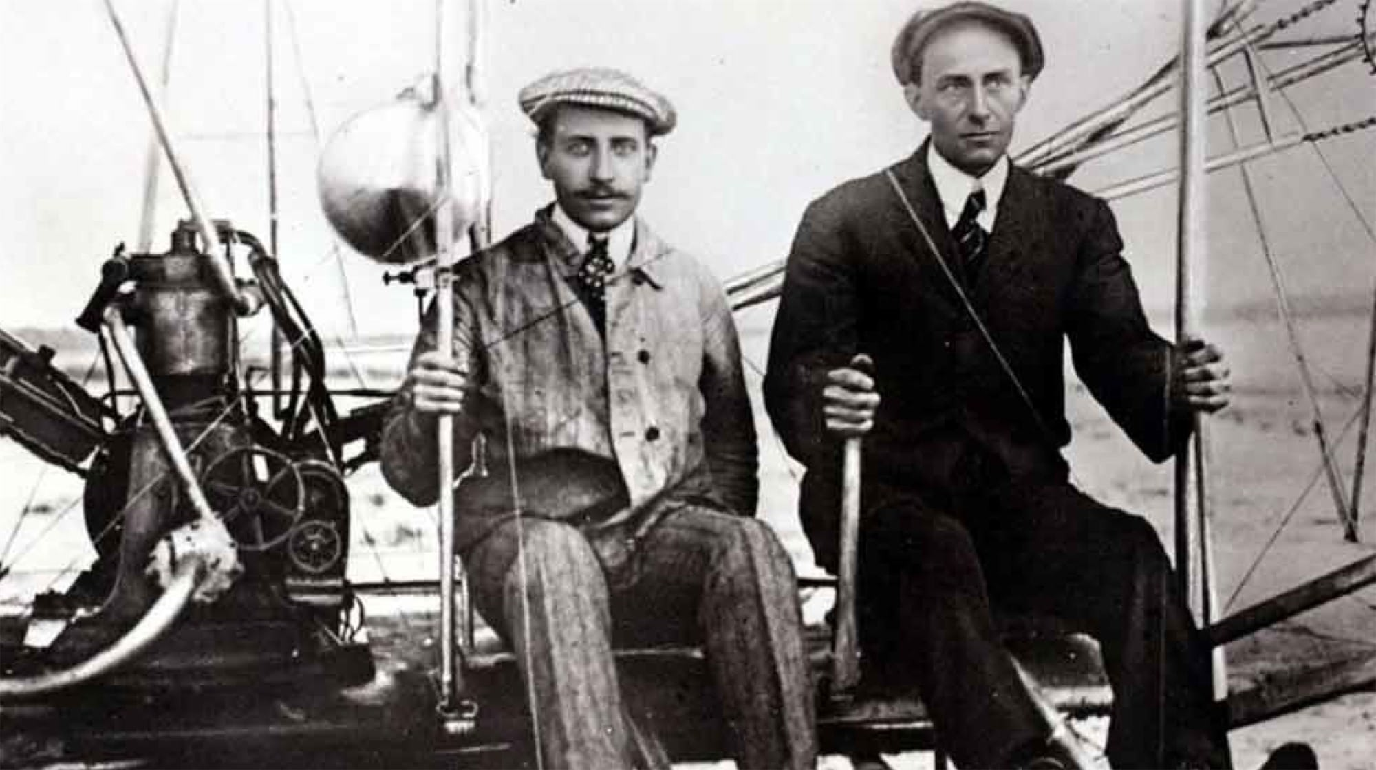

Slide 11
BOLDNESS from Present Opposition
They seized Peter and John and, because it was evening, they put them in jail until the next day… when they say the courage of Peter and John and realised that they were unschooled, ordinary men, they were astonished and they took note that these men had been with Jesus… [they] commanded them not to speak or teach at all in the name of Jesus… After further threats they let them go.
- ACTS 4:3, 13, 18

Slide 12
Consider it all joy, my brethren, when you encounter various trials knowing that the testing of your faith produces endurance, and let endurance have its perfect result so that you may be perfect and complete, lacking in nothing.
- JAMES 1:2

Slide 13
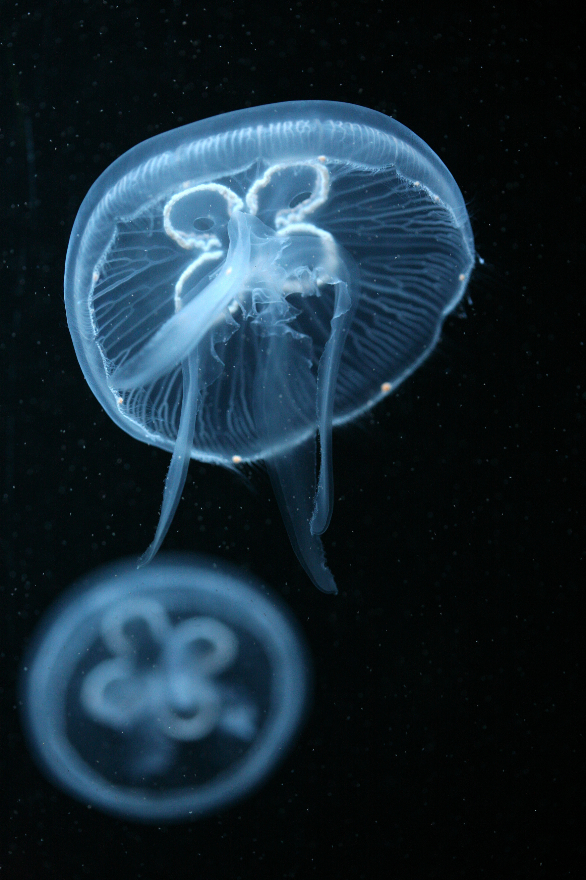

Slide 14
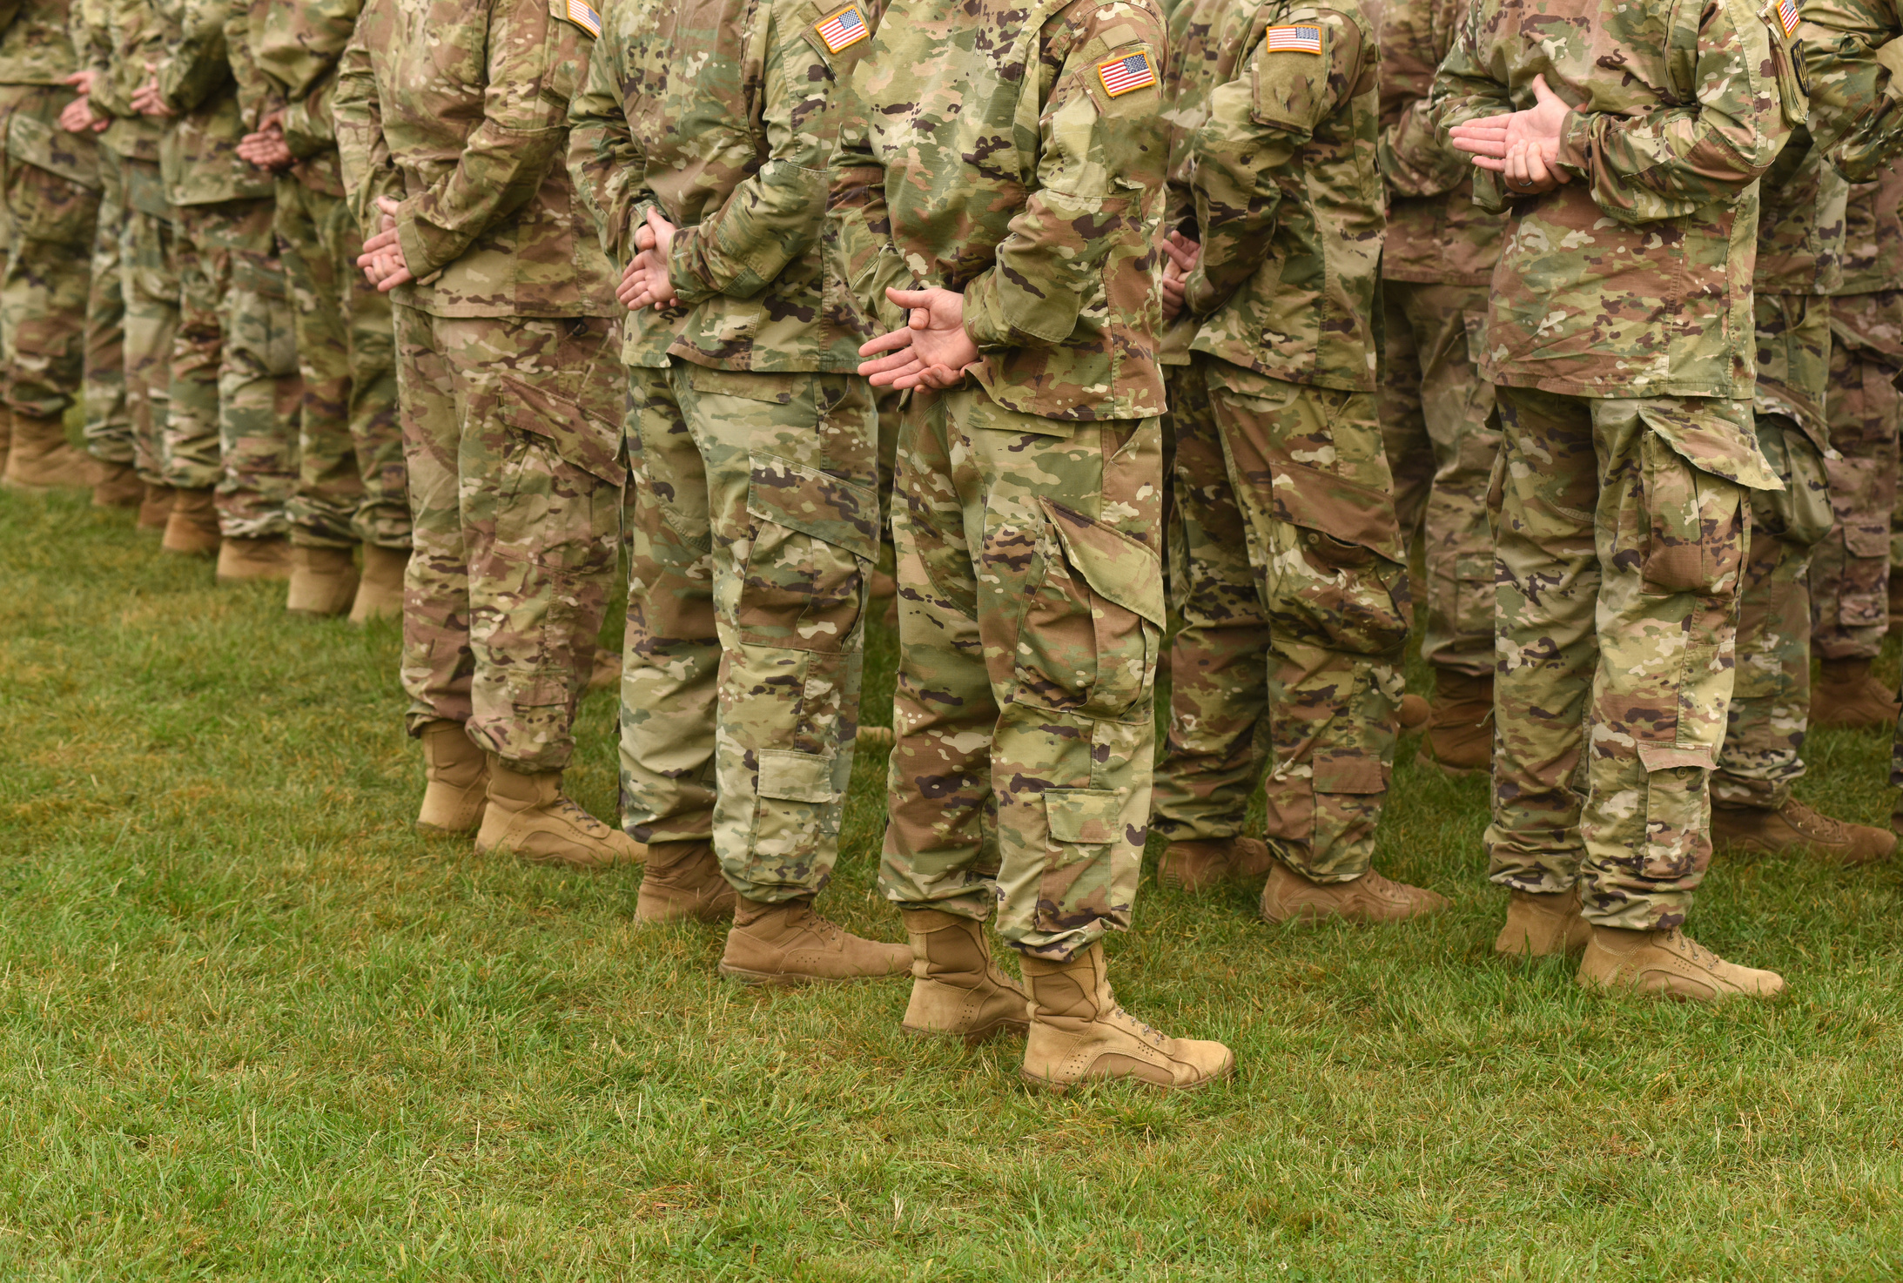

Slide 15
In this world you will have trouble. But take heart! I have overcome the world.
- JOHN 16:33

Slide 16
BOLDNESS from a Praying Church
On their release, Peter and John went back to their own people and reported all that the chief priests and the elders had said to them. When they heard this, they raised their voices together in prayer to God.
- ACTS 4:23-24

Slide 17
Satan dreads nothing but prayer. His one concern is to keep the saints from praying. He fears nothing from prayerless studies, prayerless work, prayerless religion. He laughs at our toil, mocks our wisdom, but trembles when we pray.
- SAMUEL CHADWICK

Slide 18
Prayer is by far the most common spiritual practice… but people pray mostly alone. It is a solitary activity defined primarily by the immediate needs and concerns of the individual. Corporate prayer and corporate needs are less compelling drivers in people's prayer lives.
- BARNA GROUP

Slide 19
I tell you that if two of you on earth agree about anything they ask for, it will be done for them by my Father in heaven. For where two or three gather in my name, there am I with them.
- MATTHEW 18:19-20

Slide 20
The Cinderella of the church of today is the prayer meeting. This handmaid of the Lord is unloved and unwooed because she is not dripping with the pearls of intellectualism, nor glamorous with the silks of philosophy; neither is she enchanting with the tiara of psychology.
- LEONARD RAVENHILL
Why Revival Tarries

Slide 21
BOLDNESS from a Powerful God
After they prayed, the place where they were meeting was shaken. And they were all filled with the Holy Spirit and spoke the word of God boldly.
- ACTS 4:31

Slide 22
To the thirsty I will give water without cost from the spring of the water of life. Those who are victorious will inherit all this, and I will be their God and they will be my children. But the cowardly, the unbelieving, the vile, the murderers, the sexually immoral, those who practice magic arts, the idolaters and all liars—they will be consigned to the fiery lake of burning sulfur.
- REVELATION 21:6-8

Slide 23


Slide 24
