Slide 1

A Matter of Life and Death
Michael Christie

Slide 2


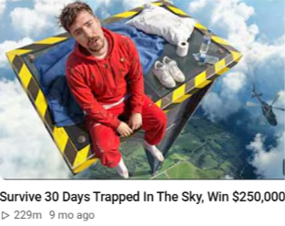



Slide 3
No man knows what he is living for until he knows what he'll die for.
- PETER BERTOCCI

Slide 4
ACTS 6:8-7:2, 51-60
⁸ Now Stephen, a man full of God’s grace and power, performed great wonders and signs among the people. ⁹ Opposition arose, however, from members of the Synagogue of the Freedmen (as it was called)—Jews of Cyrene and Alexandria as well as the provinces of Cilicia and Asia—who began to argue with Stephen.

Slide 5
¹⁰ But they could not stand up against the wisdom the Spirit gave him as he spoke.
¹¹ Then they secretly persuaded some men to say, “We have heard Stephen speak blasphemous words against Moses and against God.”
¹² So they stirred up the people and the elders and the teachers of the law. They seized Stephen and brought him before the Sanhedrin…

Slide 6
¹⁵ All who were sitting in the Sanhedrin looked intently at Stephen, and they saw that his face was like the face of an angel.
7 ¹ Then the high priest asked Stephen, “Are these charges true?”
² To this he replied…
⁵¹ “You stiff-necked people! Your hearts and ears are still uncircumcised. You are just like your ancestors: You always resist the Holy Spirit!

Slide 7
⁵² Was there ever a prophet your ancestors did not persecute? They even killed those who predicted the coming of the Righteous One.
And now you have betrayed and murdered him— ⁵³ you who have received the law that was given through angels but have not obeyed it.”
⁵⁴ When the members of the Sanhedrin heard this, they were furious and gnashed their teeth at him.

Slide 8
⁵⁵ But Stephen, full of the Holy Spirit, looked up to heaven and saw the glory of God, and Jesus standing at the right hand of God.
⁵⁶ “Look,” he said, “I see heaven open and the Son of Man standing at the right hand of God.”
⁵⁷ At this they covered their ears and, yelling at the top of their voices, they all rushed at him, ⁵⁸ dragged him out of the city and began to stone him.

Slide 9
Meanwhile, the witnesses laid their coats at the feet of a young man named Saul.
⁵⁹ While they were stoning him, Stephen prayed, “Lord Jesus, receive my spirit.”
⁶⁰ Then he fell on his knees and cried out, “Lord, do not hold this sin against them.” When he had said this, he fell asleep.

Slide 10
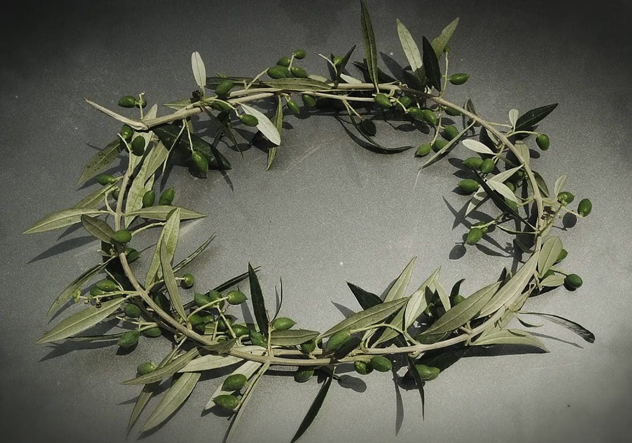
Run in such a way as to get the prize. Everyone who competes in the games goes into strict training. They do it to get a crown [Gk. stephanos] that will not last, but we do it to get a crown that will last forever.
- 1 CORINTHIANS 9:24-25

Slide 11
The CHARACTER of Christ
Now Stephen, a man full of God’s grace and power, performed great wonders and signs among the people.
- ACTS 6:8

Slide 12


Slide 13

Do not get drunk on wine, which leads to debauchery. Instead, be filled with the Spirit.
- EPHESIANS 5:18

Slide 14
The thief comes only to steal and kill and destroy; I have come that they may have life, and have it to the full.
- JOHN 10:10

Slide 15
The COURAGE of Christ
You stiff-necked people! Your hearts and ears are still uncircumcised. You are just like your ancestors: You always resist the Holy Spirit! Was there ever a prophet your ancestors did not persecute? They even killed those who predicted the coming of the Righteous One. And now you have betrayed and murdered him— you who have received the law… but have not obeyed it.
- ACTS 7:51-53

Slide 16
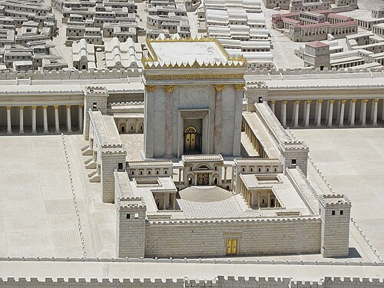
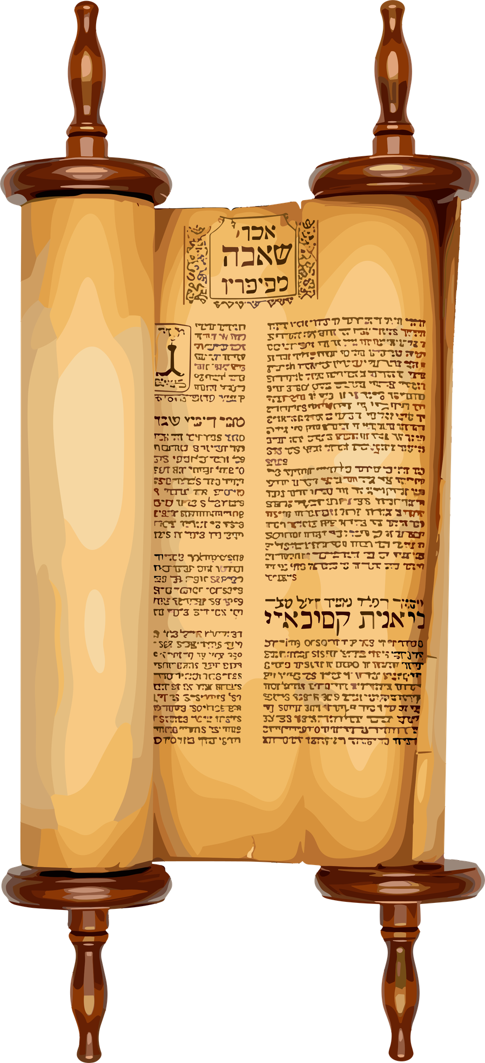
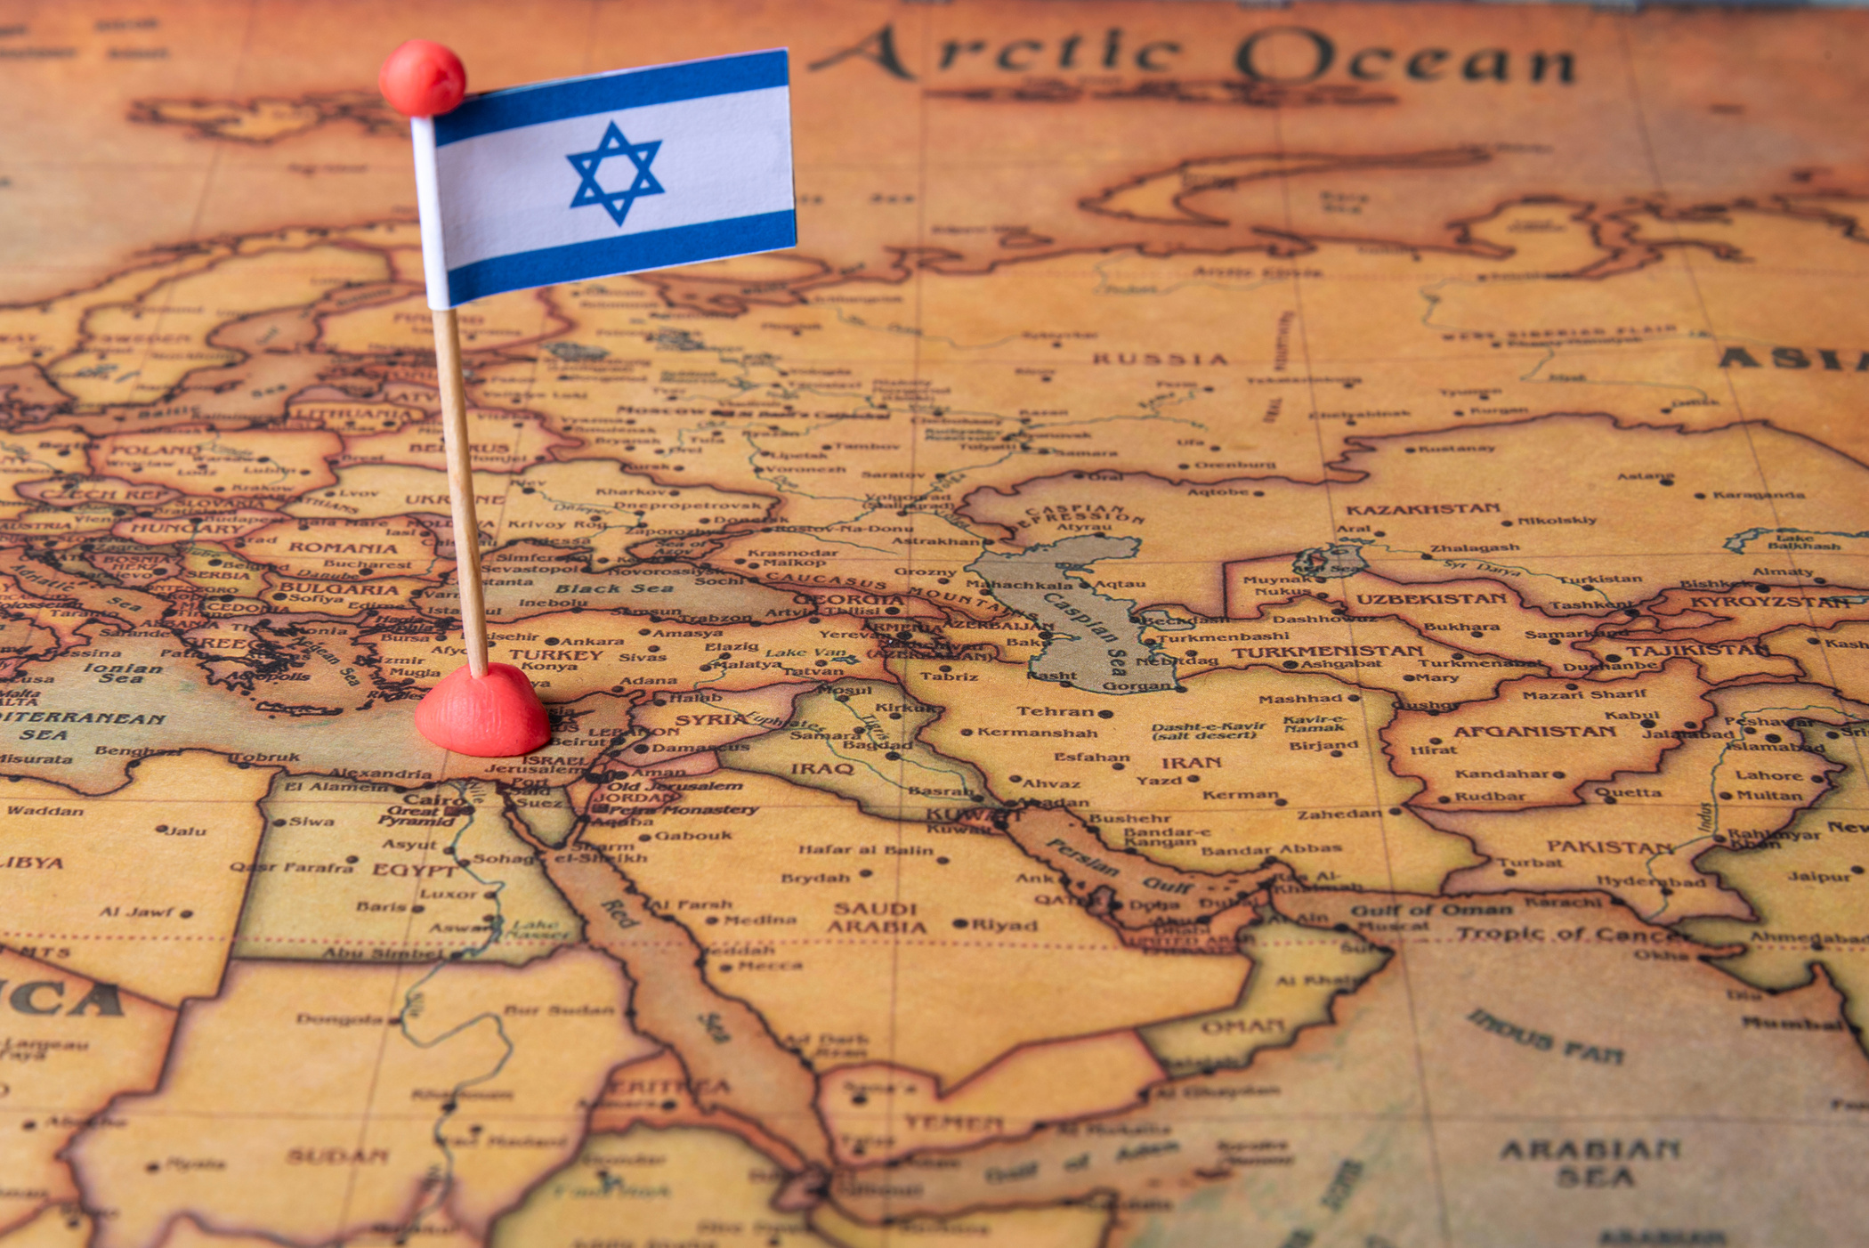

Slide 17
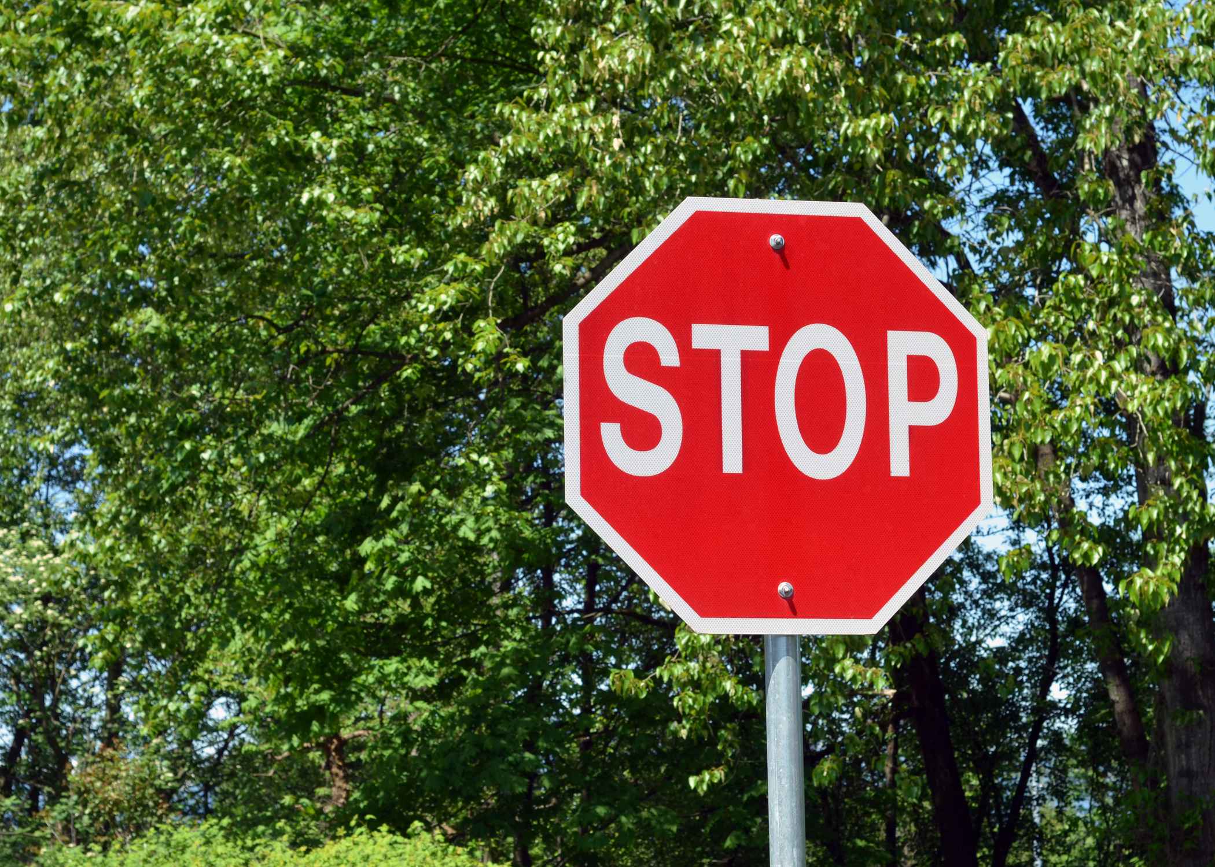

Slide 18
Courage is almost a contradiction in terms. It means a strong desire to live taking the form of a readiness to die.
- G.K. CHESTERTON

Slide 19
The COUNTENANCE of Christ
Stephen, full of the Holy Spirit, looked up to heaven and saw the glory of God, and Jesus standing at the right hand of God. “Look,” he said, “I see heaven open and the Son of Man standing at the right hand of God.” At this they covered their ears and, yelling at the top of their voices, they all rushed at him, dragged him out of the city and began to stone him.
- ACTS 7:55-58

Slide 20
Whoever acknowledges me before others, I will also acknowledge before my Father in heaven.
- MATTHEW 10:32

Slide 21
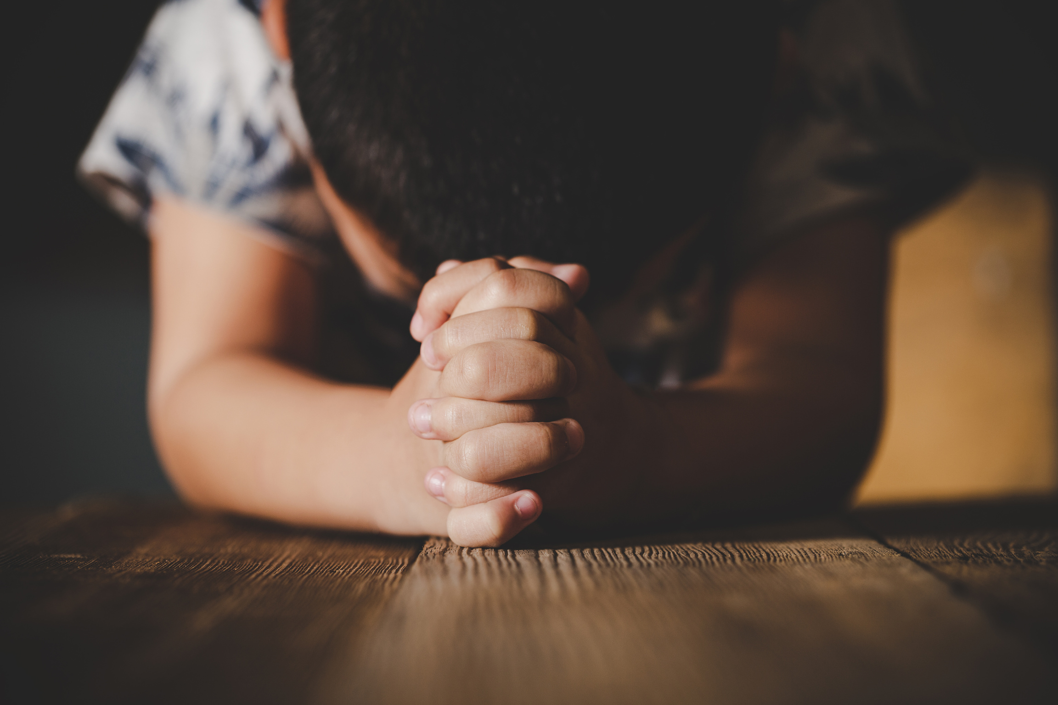

Slide 22
Whoever wants to be my disciple must deny themselves and take up their cross daily and follow me. For whoever wants to save their life will lose it, but whoever loses their life for me will save it.
- LUKE 9:23-24

Slide 23
To deny oneself is to be aware only of Christ and no more of self, to see only him who goes before and no more the road which is too hard for us. Once more, all that self-denial can say is: "He leads the way, keep close to him.
- DIETRICH BONHOEFFER
The Cost of Discipleship

Slide 24
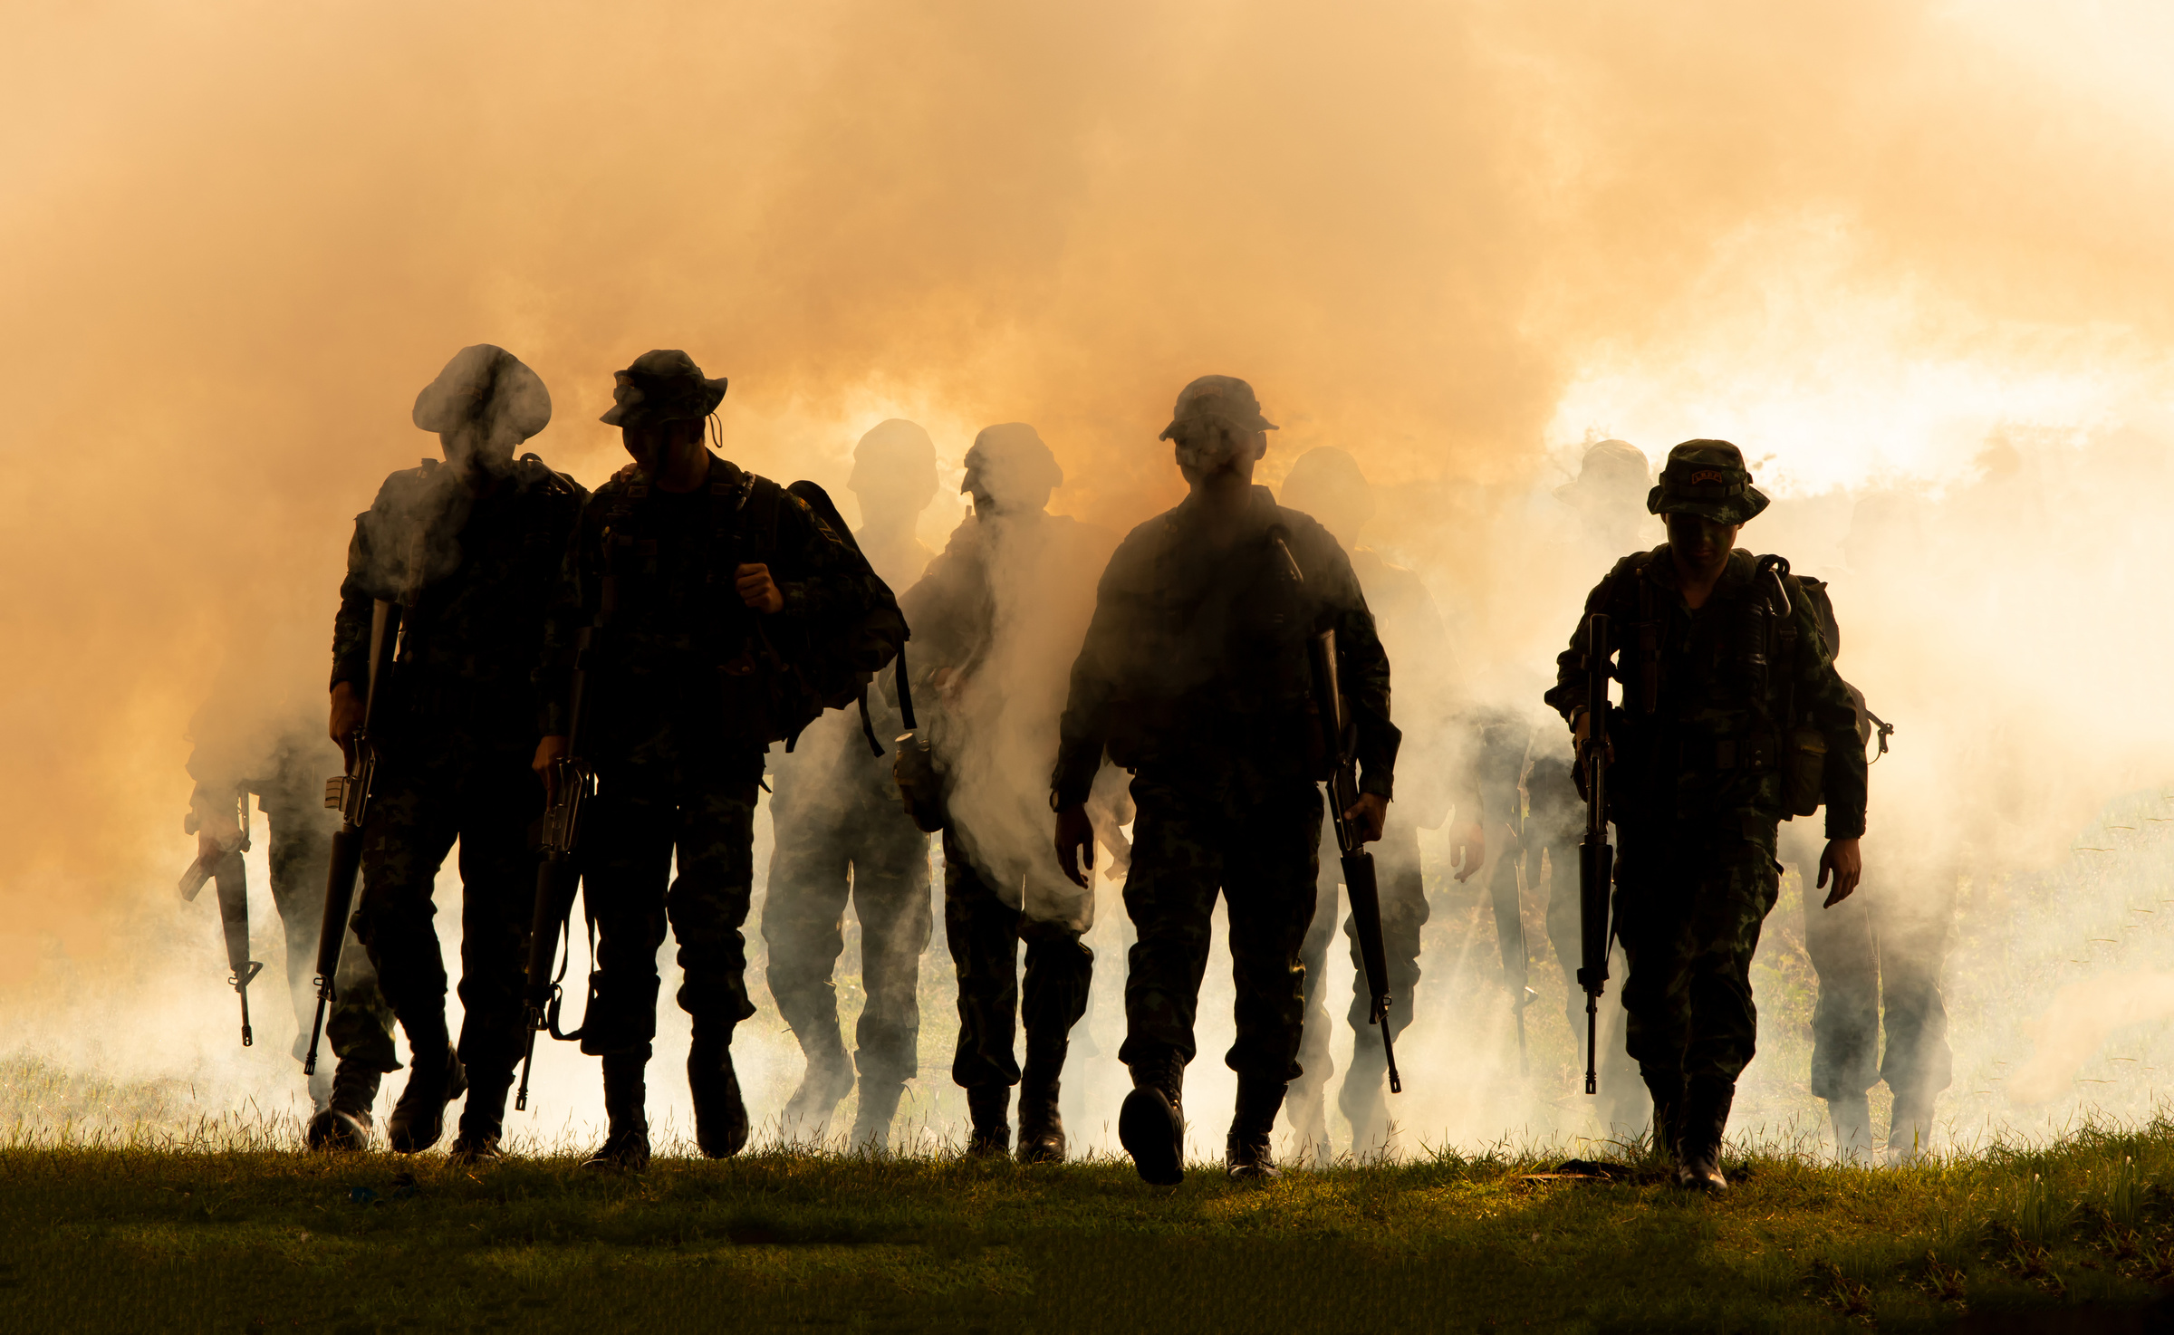

Slide 25
I have been crucified with Christ and I no longer live, but Christ lives in me. The life I now live in the body, I live by faith in the Son of God, who loved me and gave himself for me.
- GALATIANS 2:20

